Slide 1

University of Nebraska-Lincoln
A Brief Introduction to AI Fundamentals and Algorithms --
the Application and Impacts on Translation
Adarsha Bhattarai and Dongming Peng
Department of Electrical and Computer Engineering
University of Nebraska-Lincoln
26 August 2023

Slide 2

Agenda
What is Artificial Intelligence(AI)?
History of AI
Machine Learning
Natural Language Processing
Deep Learning
Machine Translation
Convolutional Neural Network
Large Language Models
Risks of AI
Future Direction
Summary

Slide 3
What is Artificial Intelligence(AI)?
What is Intelligence?
Human made machine or human written program to think and learn like humans
“The branch of computer science that is concerned with the automation of intelligent behavior(George F. Luger, William A. Stubblefield)
The capability of a machine to imitate intelligent human behavior.

Slide 4
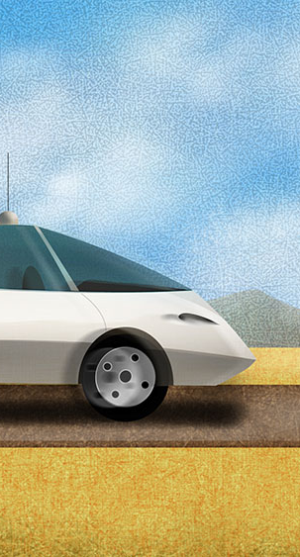
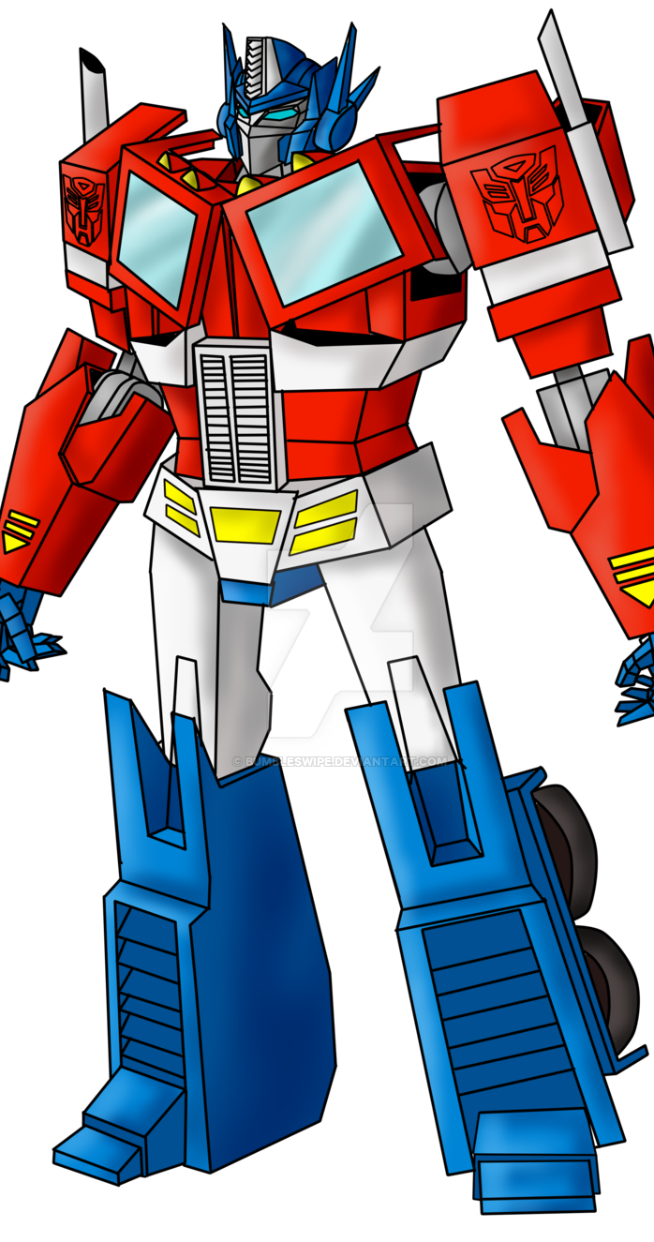
Principles of AI
Intelligent machines can understand, think, plan, and talk
Perceiving the environment and the ability to move and manipulate objects
It is the science and engineering of developing intelligent machines with intelligent computer programs

Slide 5
History of AI
1950
In 1950 Alan Turing published a paper titled “Computing Machinery and Intelligence” that asked, “Can machines think?”
1956
In 1956 Darthmouth Conference the term ‘AI’ was proposed
1960s and the 1970s
In 1960s and the 1970s, AI research was focused on the development of Knowledge based system and expert systems
Late 1980s and 1990s
In late 1980s and 1990s , the impact of the back propagation algorithm
2023
Until Now: Machine Learning, Deep Learning, Natural Language Processing, ChatGPT and many more

Slide 6
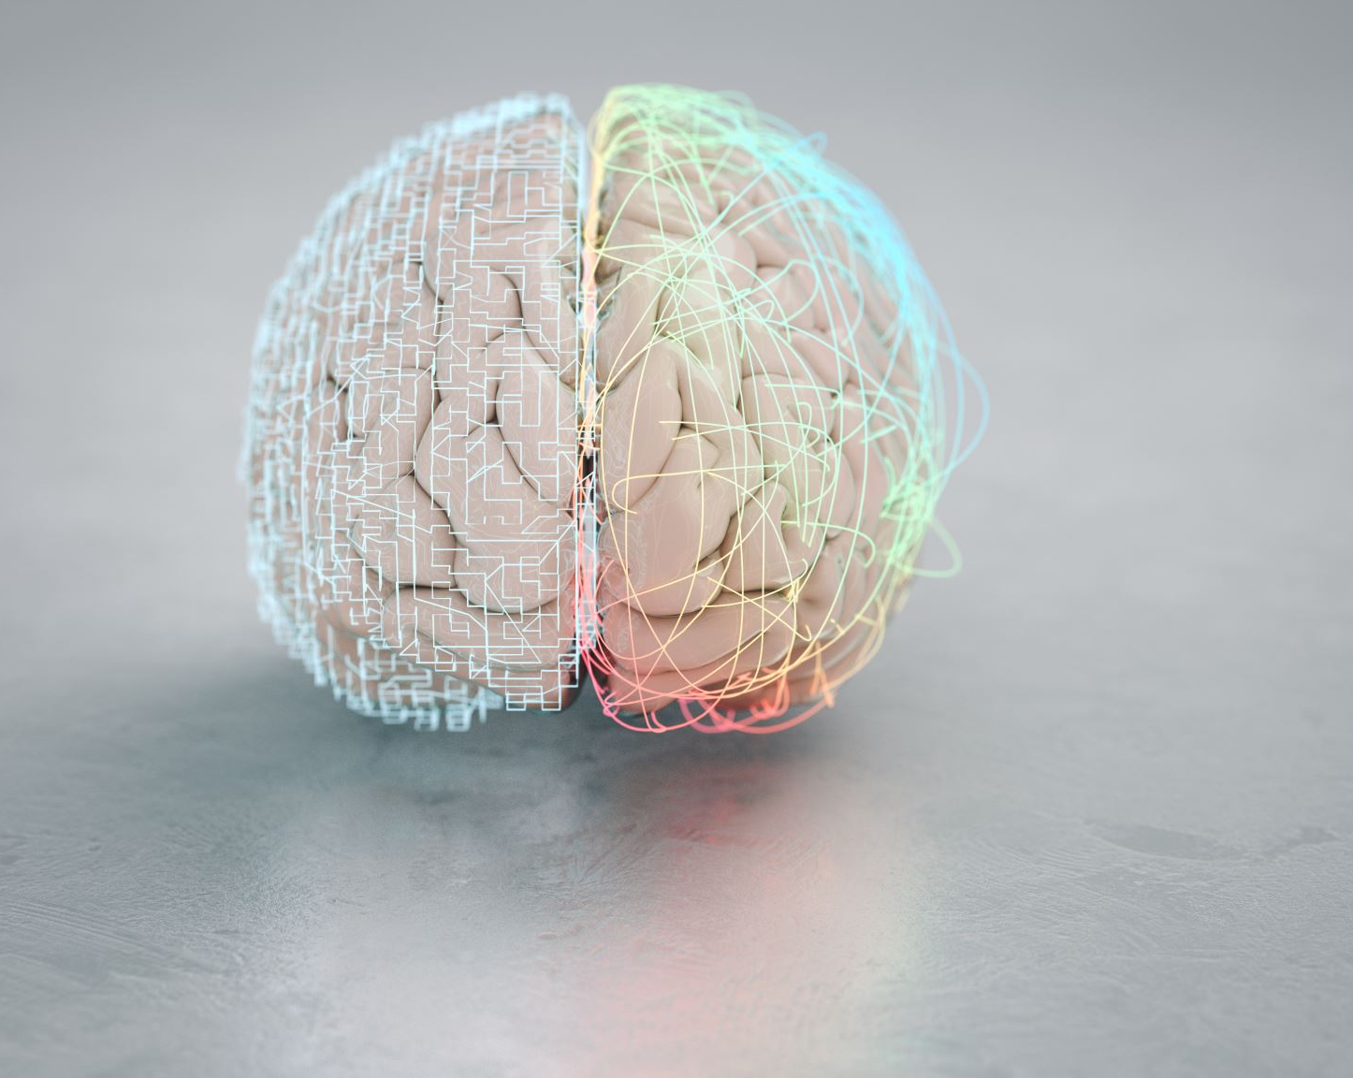
Machine Learning
AI and Machine Learning are different
AI is a vast concept, while ML is the widely used method of AI
ML is a subfield of AI
ML is programming machines to optimize a performance criterion using datasets or experience

Slide 7
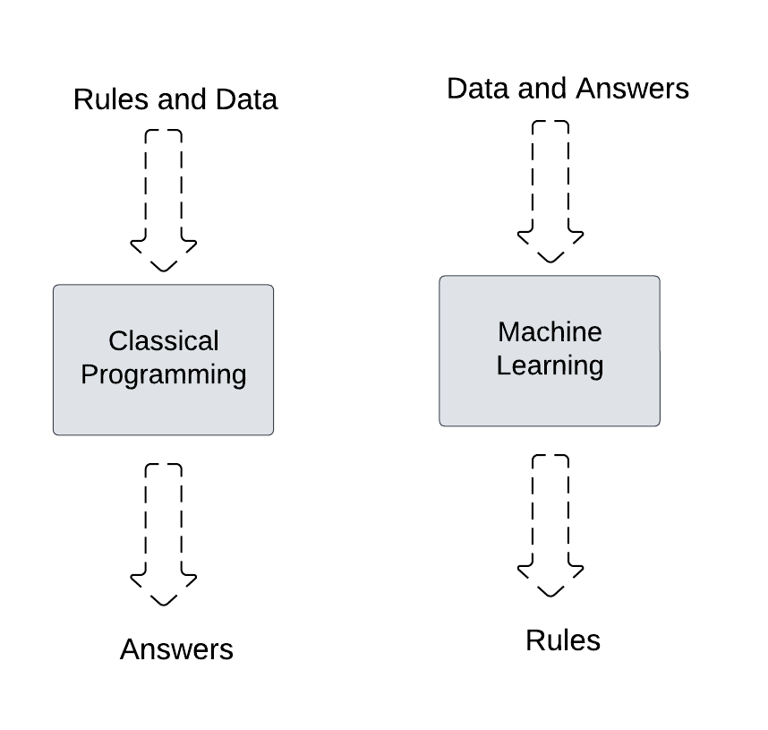
Classical Programming vs Machine Learning

Slide 8
Datasets in Machine Learning
Data or examples
Used to train, evaluate and test ML models
Two main components: Feature and Labels
Text data, Audio data, Image data, Video data and Tabular data

Slide 9

MNIST Handwritten Datasets
This is a dataset of 60,000 28x28 grayscale images of the 10 digits, along with a test set of 10,000 images.
https://keras.io/api/datasets/mnist/

Slide 10
MIT-BIH Arrhythmia Database
https://archive.physionet.org/cgi-bin/atm/ATM

Slide 11
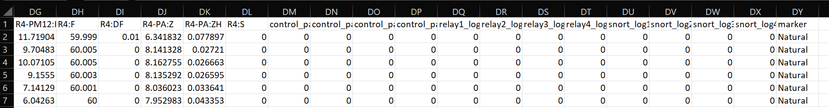
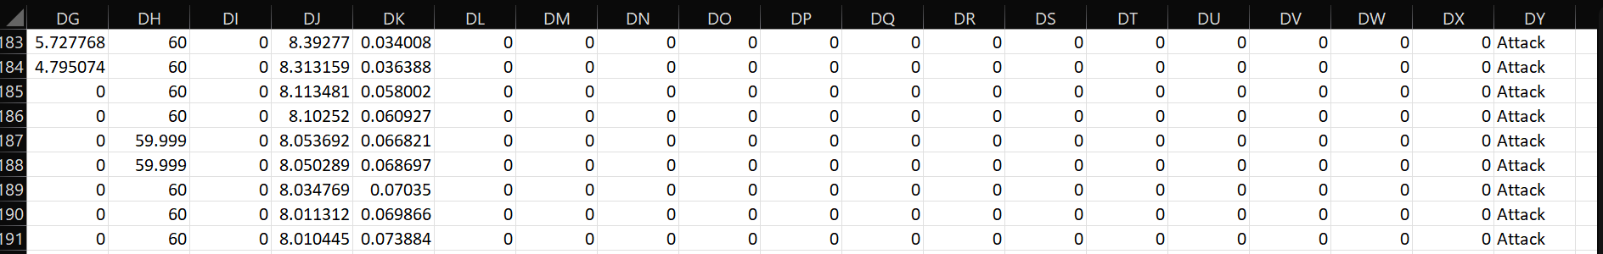
Power System Dataset
Tabular Datasets with labels
https://sites.google.com/a/uah.edu/tommy-morris-uah/ics-data-sets

Slide 12
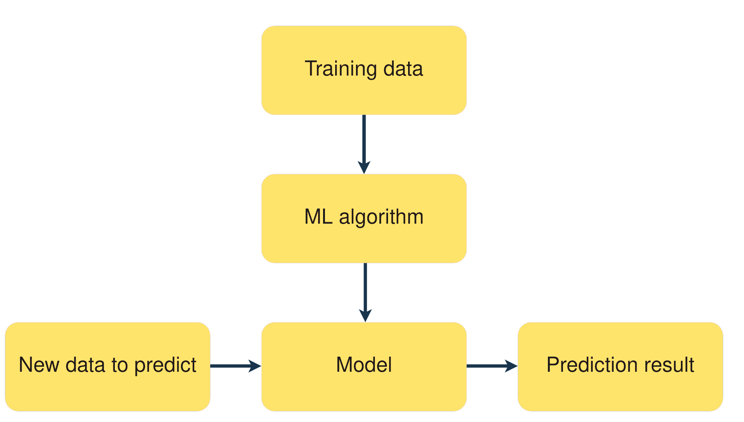
ML Algorithm
Set of step-by-step rules that an ML model rely on
Design ML model that learn from dataset and make prediction/decisions
Learning Style
Supervised Learning
Unsupervised Learning
Semi-Supervised Learning

Slide 13

Ordinary Example
AI Model
It is a Dog!
Input/Command
Process/Think/ Learn
Output/Response

Slide 14

Application of ML
Market Analysis
Finance
Manufacturing
Medical
Bioinformatics
Telecommunication
Search Engines
Natural Language Processing/Understanding

Slide 15
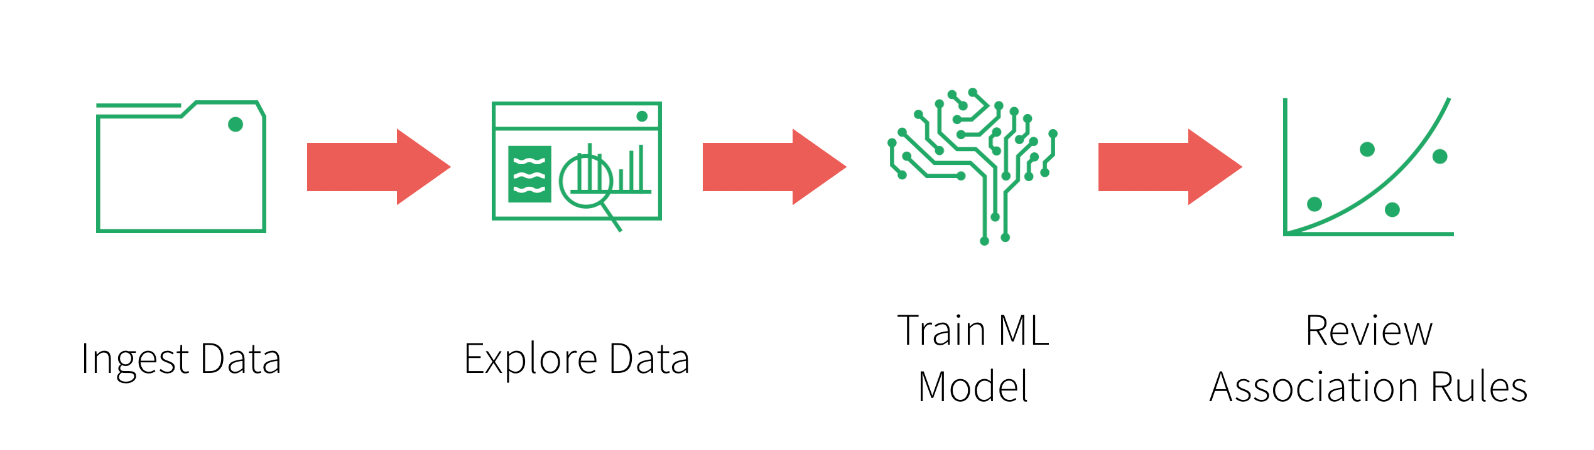
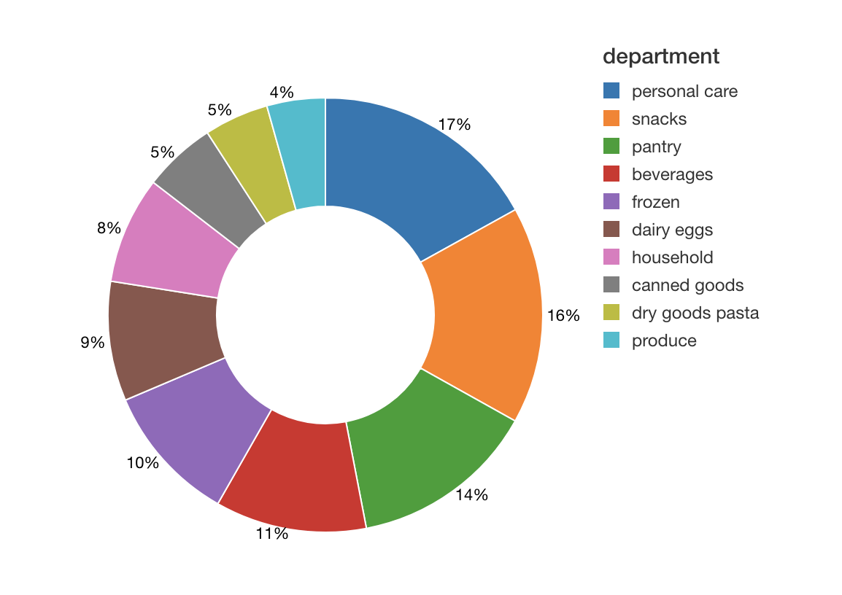
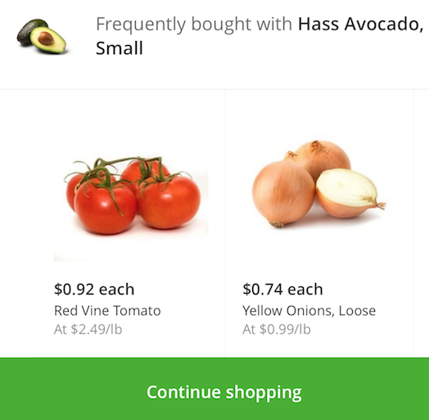
Market Basket Analysis
https://www.databricks.com/blog/2018/09/18/simplify-market-basket-analysis-using-fp-growth-on-databricks.html

Slide 16
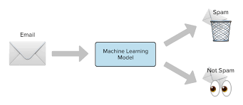
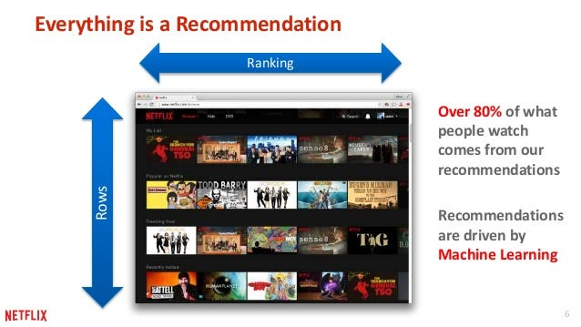
ML Models for Specific Application
Spam Detection: Naïve Bayes, Support Vector Machines(SVM)
Anomaly Detection: K-Nearest Neighbor(KNN), Isolation Forest
Finance: Logistic Regression, Random Forrest
Fraud Detection: Random Forest, Gradient Boosting
Sentiment Analysis: Naïve Bayes, SVM
Recommendation: K-NN
https://towardsdatascience.com/prototyping-a-recommender-system-step-by-step-part-1-knn-item-based-collaborative-filtering-637969614ea

Slide 17
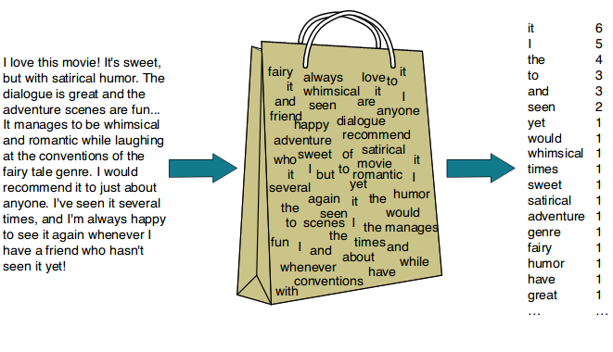
Natural Language Processing(NLP)
To process information contained in natural language
We use AI/ML models to classify texts-based information
Two components:
Natural Language Understanding
Natural Language Generation

Slide 18
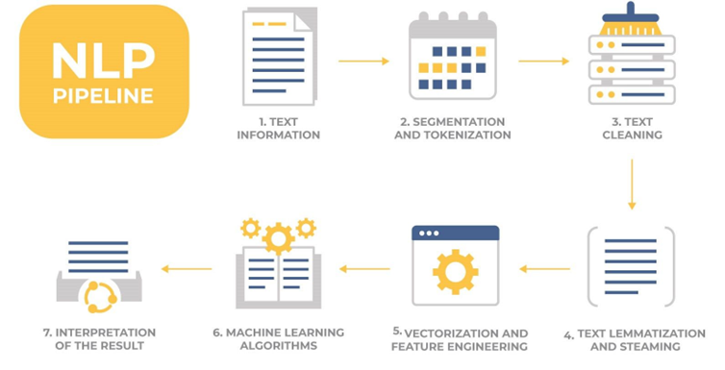
NLP Pipeline
Original Text: "The cats are jumping on the roofs."
Tokenization: ["The", "cats", "are", "jumping", "on", "the", "roofs"]
Lemmatization: ["The", "cat", "be", "jump", "on", "the", "roof"]
Vectorization (e.g., using Bag of words): Numeric vectors representing the lemmatized tokens.
https://thmachne.blogspot.com/2021/07/nlp-or-machine-learning.html

Slide 19
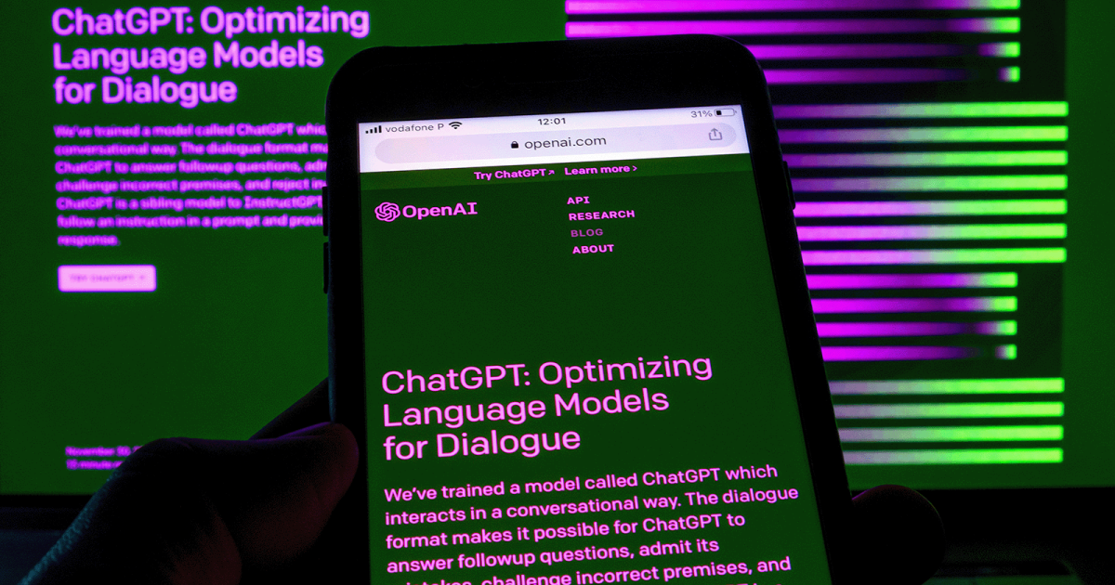
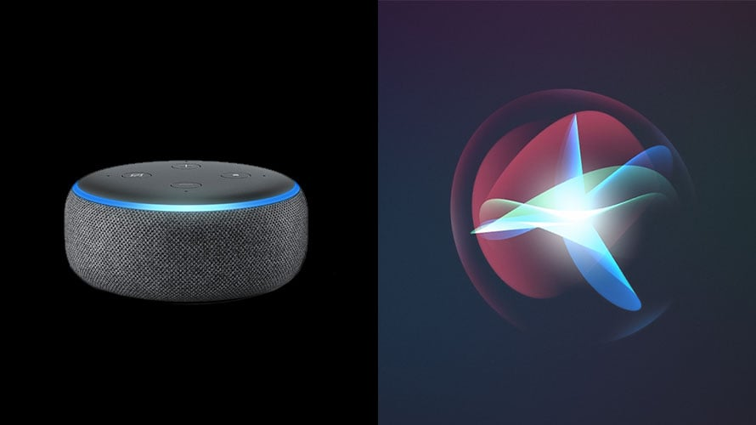
Application of NLP
Text Classification
Machine Translation
Speech Recognition
Chatbots and Virtual Assistants
Information Retrieval
Content Generation
Accessibility

Slide 20
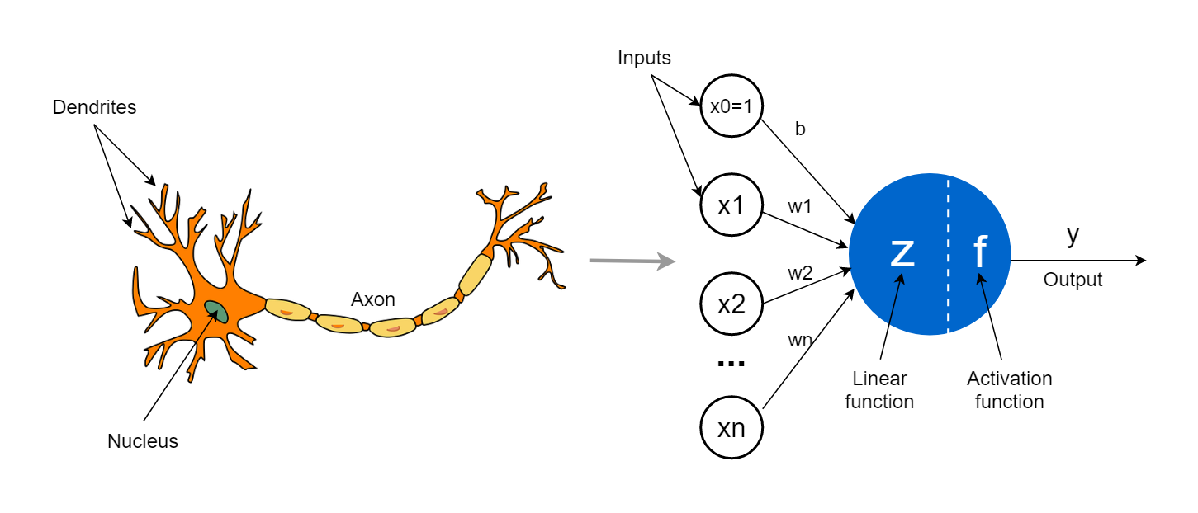
Deep Learning
Subfield of Machine Learning
Development of artificial neural network
Inspired by the structure and function of the human brain
Image from: https://towardsdatascience.com/the-concept-of-artificial-neurons-perceptrons-in-neural-networks-fab22249cbfc

Slide 21
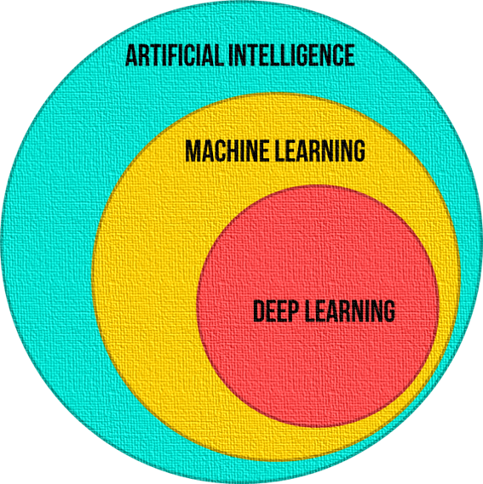
AI vs ML vs DL
1
2
3

Slide 22
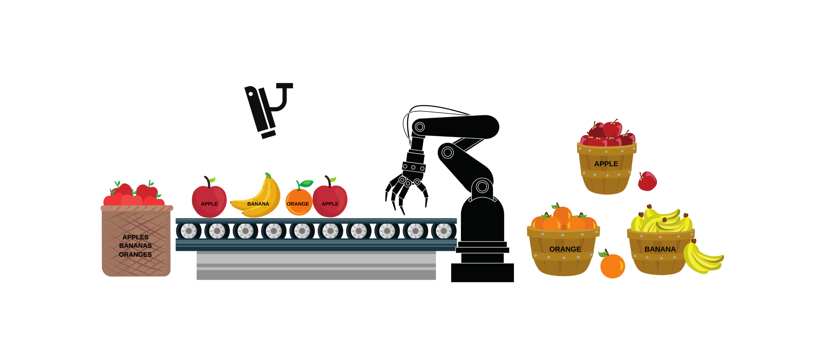
1. Artificial Intelligence
https://www.advancinganalytics.co.uk/blog/2021/12/15/understanding-the-difference-between-ai-ml-and-dl-using-an-incredibly-simple-example

Slide 23
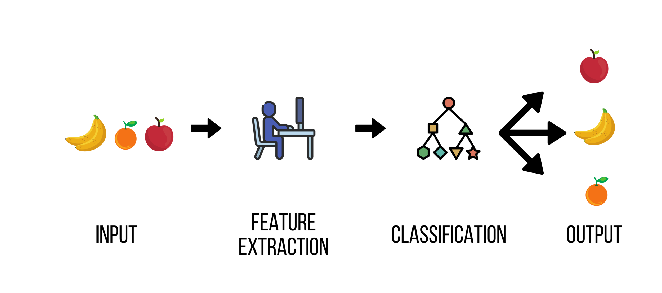
2. Machine Learning
https://www.advancinganalytics.co.uk/blog/2021/12/15/understanding-the-difference-between-ai-ml-and-dl-using-an-incredibly-simple-example

Slide 24
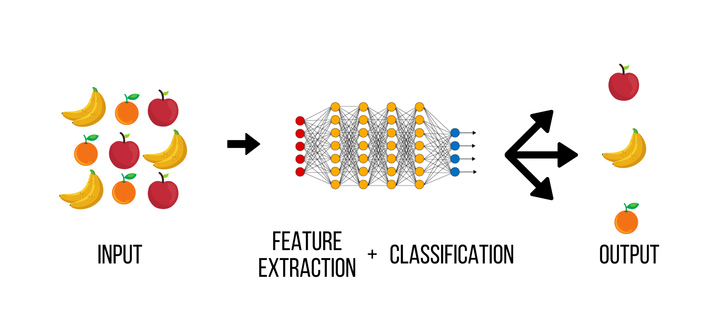
3. Deep Learning
https://www.advancinganalytics.co.uk/blog/2021/12/15/understanding-the-difference-between-ai-ml-and-dl-using-an-incredibly-simple-example

Slide 25

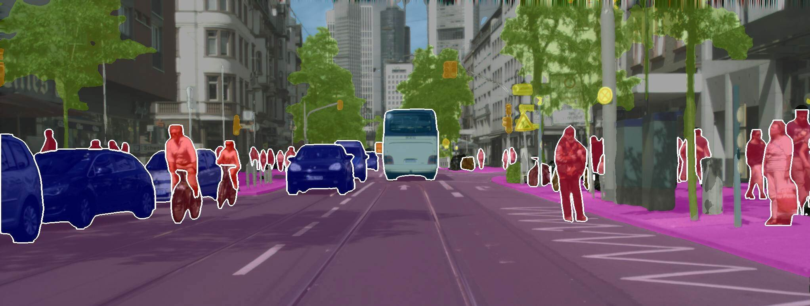
Application of Deep Learning
Computer Vision
Natural Language Processing: MT
Speech Recognition
Autonomous Vehicles
Healthcare
Energy
Agriculture

Slide 26
Machine Translation(MT)
Subfield of computational linguistics
Deep Learning has given rise to Neural Machine Translation(NMT)
NMT is the most powerful algorithm to perform translation
Example: Google Translate, DeepL
Massive datasets of translated sentences are used to train a model capable of translating between any two languages

Slide 27
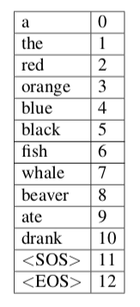
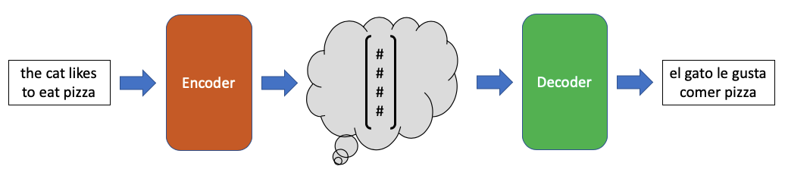
Encoder and Decoder Algorithm For NMT
Figure : Encoder Decoder structure translating the English sentence
Table : Mini-vocabulary for the English language
Encoder Decoder are DL models such as Convolutional Neural Network and Recurrent Neural Network
Image from: https://towardsdatascience.com/neural-machine-translation-15ecf6b0b

Slide 28
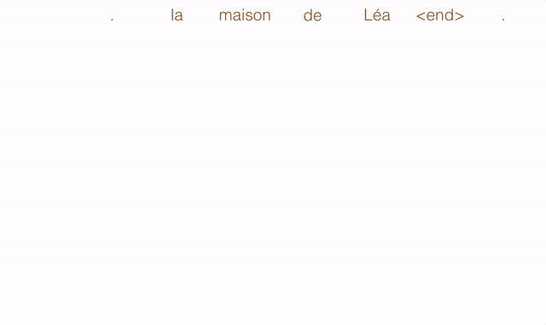
Convolutional Neural Network
Deep Learning Algorithm
Used for various applications such as image classification, medical diagnosis and translation
The basic concept underlying CNNs for translation is that it compute a vector for every possible phrase
https://engineering.fb.com/2017/05/09/ml-applications/a-novel-approach-to-neural-machine-translation/
https://medium.com/ai-society/why-convolutional-neural-networks-are-a-great-architecture-for-machine-translation-9258ca1263a8

Slide 29
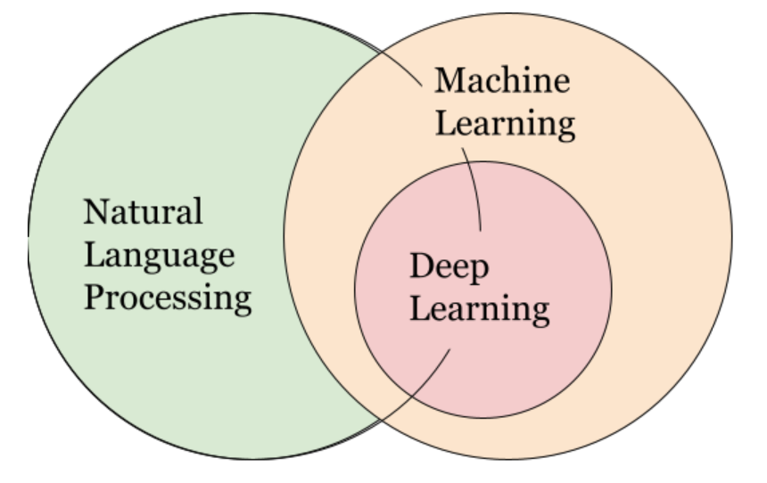
NLP, ML and DL

Slide 30
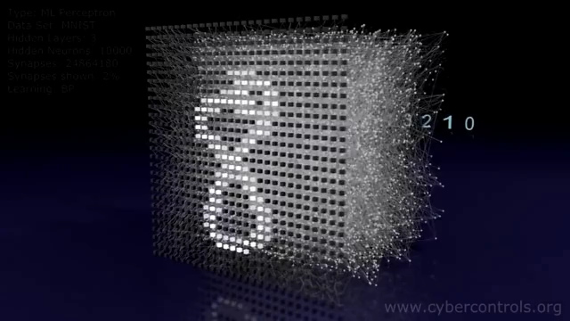
Classifying Images of Handwritten Digits using Multi-Layer Perceptron
Video:
https://thumbs.gfycat.com/SlushySlimGalapagosmockingbird-mobile.mp4

Slide 31
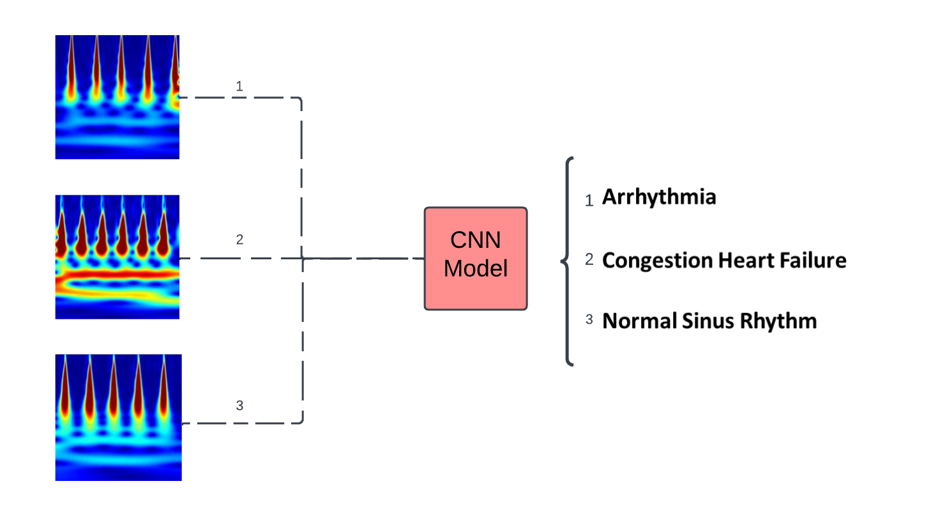
Another CNN Application
Various ECG Scalograms
Input/Command
Process/Think/ Learn
Output/Response

Slide 32

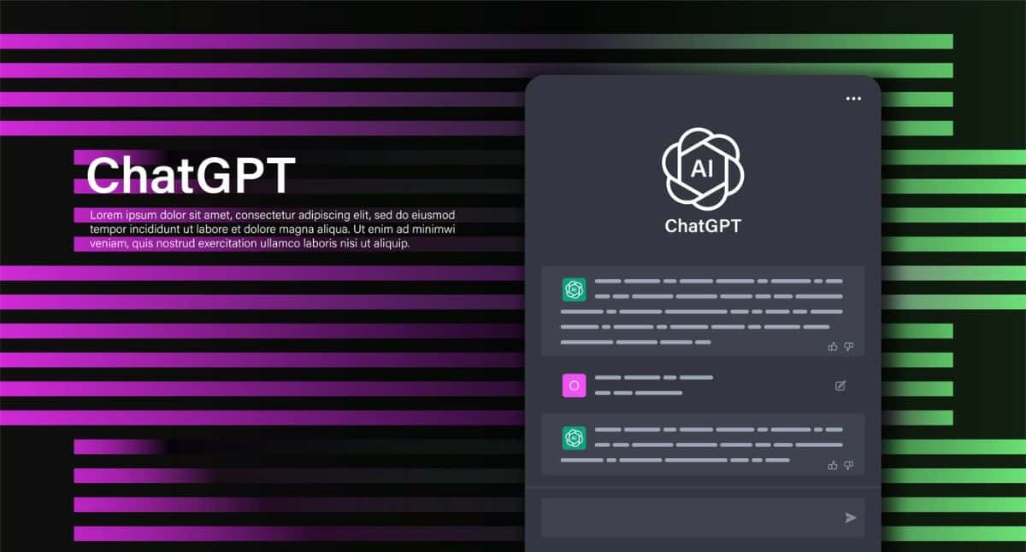

Large Language Models(LLM)
Technology to understand and generate human language
Based on Deep Learning
More specifically based on transformer architecture
Trained on huge amount of texts data
Fine-tuning for specific application
https://crfm.stanford.edu/2023/03/13/alpaca.html https://blog.google/technology/ai/google-bard-updates-io-2023/ https://blog.enterprisedna.co/how-to-use-chat-gpt/

Slide 33
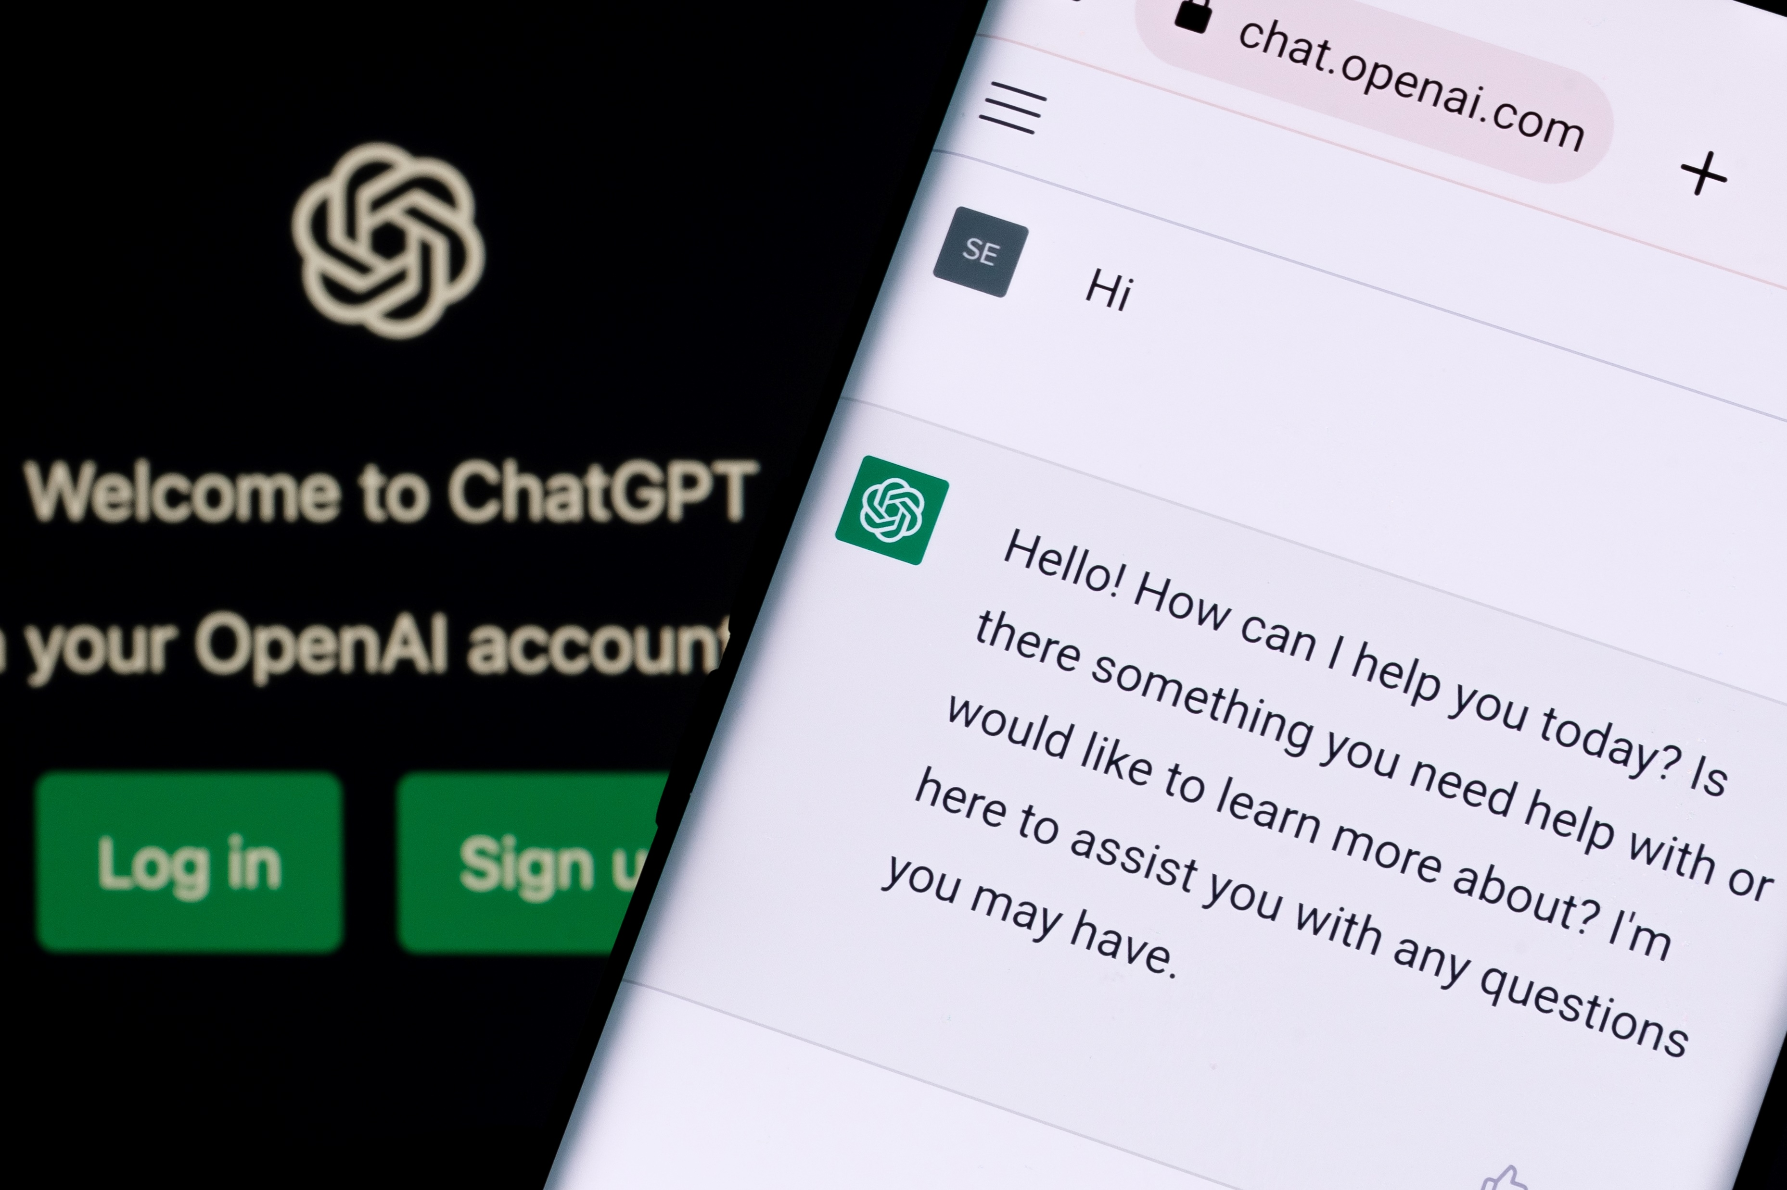
ChatGPT
https://chat.openai.com
Model names: GPT-3.5 / GPT-4
Content Generation
Virtual Assistants
Language Translation
Teaching Assistant
Research

Slide 34
How many languages do you know?
ChatGPT
Croatian
Slovak
Slovenian
Lithuanian
Latvian
Estonian
Icelandic
Welsh
Scottish Gaelic
Irish
Maori
Persian (Farsi)
Tamil
Telugu
Kannada
Malayalam
Punjabi
Gujarati
Marathi
English
Spanish
French
German
Chinese
Japanese
Russian
Arabic
Italian
Portuguese
Dutch
Korean
Swedish
Norwegian
Danish
Finnish
Bulgarian
Serbian
Hindi
Bengali
Urdu
Turkish
Greek
Hebrew
Polish
Romanian
Vietnamese
Thai
Malay
Indonesian
Filipino
Swahili
Ukrainian
Czech
Hungarian
Please note that while I have knowledge of these languages, my proficiency may vary. I'm more proficient in languages for which there is more training data available, such as English, Spanish, and French, and my performance may be less accurate in less widely represented languages. If you have a specific question or need assistance with a particular language, feel free to ask!
Bengali

Slide 35
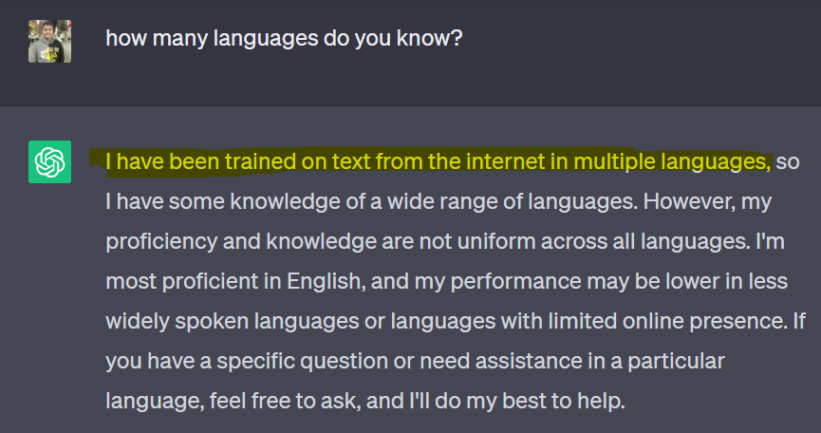
ChatGPT (2022)

Slide 36
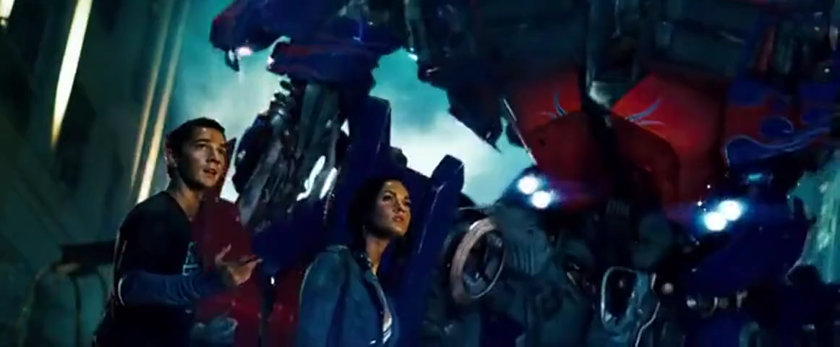
From the Movie Transformers(2007)
Video:
We have learned Earth’s languages from the world wide web

Slide 37
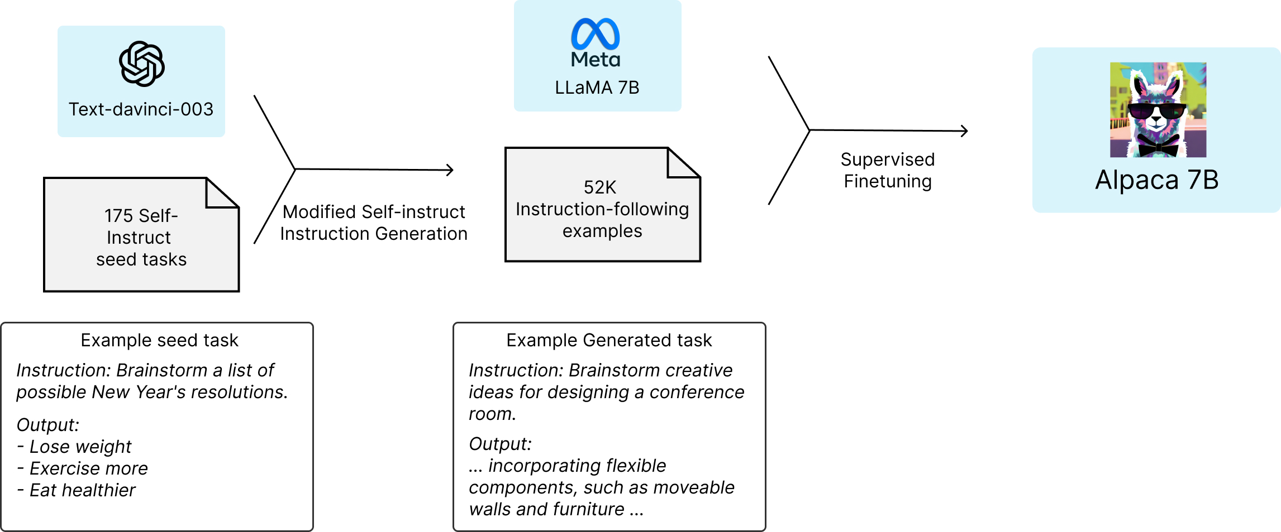
Stanford Alpaca: A Language Model
https://crfm.stanford.edu/2023/03/13/alpaca.html

Slide 38
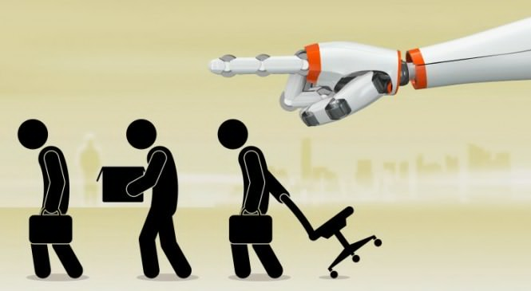

Risks of AI
Transparency
Bias and Discrimination
Privacy Concerns
Security Risks
Job Displacement
Dependence on AI
Loss of Human Connection
Existential Risks
https://www.forbes.com/sites/bernardmarr/2023/06/02/the-15-biggest-risks-of-artificial-intelligence/?sh=62915ca27066

Slide 39
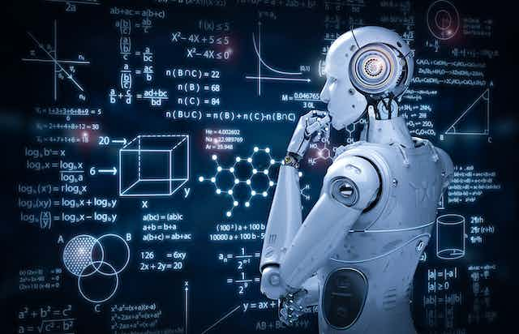
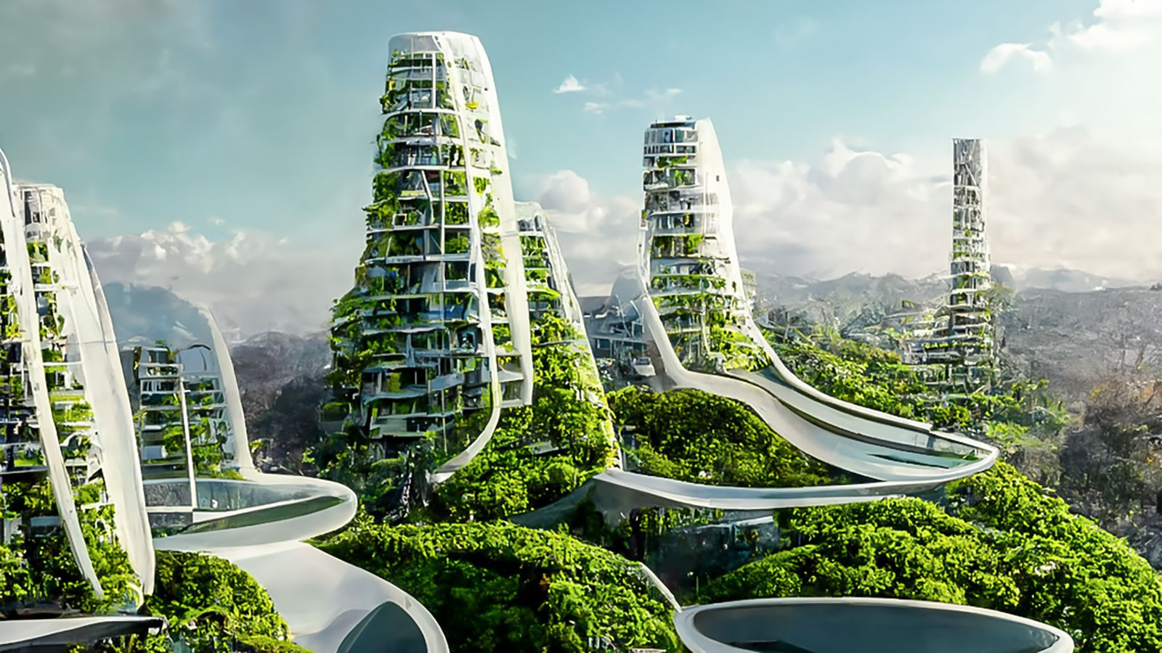
Future Direction
The future is really unknown
Undоubtedly hаve bоth роsitive аnd negative imрliсаtiоns.
However, AI will continue to get more sophisticated
Continue to impact: Transportation, Education, Healthcare, Media, Manufacturing, Customer Service and many more
https://www.simplilearn.com/future-of-artificial-intelligence-article#:~:text=leap%20of%20faith.-,Future%20of%20Artificial%20Intelligence,healthcare%2C%20banking%2C%20and%20transportation.
https://builtin.com/artificial-intelligence/artificial-intelligence-future

Slide 40
Summary 1 of 2
Intelligence: Machine replication of human thinking, learning, and behavior in automation
AI and Machine Learning differ as AI is broader; ML is its optimization subfield using data or experience.
Data or examples train ML models, comprising Features and Labels in various forms: text, audio, image, video, and tabular data.
ML algorithms are rule sets for models that learn and predict from data, including supervised, unsupervised, and semi-supervised learning.
ML finds applications in market analysis, finance, manufacturing, medical, bioinformatics, telecom, search engines, and natural language processing.
NLP processes natural language information using AI/ML models for classification, with two key components: Natural Language Understanding and Natural Language Generation.

Slide 41
Summary 2 of 2
Deep Learning (DL) is a subfield of ML focused on artificial neural network development, inspired by the human brain's structure and function.
Machine translation, a subfield of computational linguistics, is powered by Deep Learning, particularly Neural Machine Translation (NMT), exemplified by Google Translate, using extensive translated datasets for versatile language translation
CNN, a Deep Learning algorithm, finds application in image classification, medical diagnosis, and translation, using vectors to represent phrases in translation tasks.
LLM, a language model, leverages Deep Learning, specifically the transformer architecture, trained on vast text data, and fine-tuned for specific applications to understand and generate human language.
AI risks encompass transparency, bias, privacy, security, job displacement, dependence, human connection loss, and existential concerns.
The future is uncertain with both positive and negative implications, but AI will advance, influencing transportation, education, healthcare, media, manufacturing, and more.

Slide 42
References
https://keras.io/api/datasets/mnist/
https://archive.physionet.org/cgi-bin/atm/ATM
https://sites.google.com/a/uah.edu/tommy-morris-uah/ics-data-sets
https://www.databricks.com/blog/2018/09/18/simplify-market-basket-analysis-using-fp-growth-on-databricks.html
https://towardsdatascience.com/prototyping-a-recommender-system-step-by-step-part-1-knn-item-based-collaborative-filtering-637969614ea
https://thmachne.blogspot.com/2021/07/nlp-or-machine-learning.html
Image from: https://towardsdatascience.com/the-concept-of-artificial-neurons-perceptrons-in-neural-networks-fab22249cbfc
https://www.advancinganalytics.co.uk/blog/2021/12/15/understanding-the-difference-between-ai-ml-and-dl-using-an-incredibly-simple-example
Image from: https://towardsdatascience.com/neural-machine-translation-15ecf6b0b
https://thumbs.gfycat.com/SlushySlimGalapagosmockingbird-mobile.mp4
https://crfm.stanford.edu/2023/03/13/alpaca.html https://blog.google/technology/ai/google-bard-updates-io-2023/ https://blog.enterprisedna.co/how-to-use-chat-gpt/
https://crfm.stanford.edu/2023/03/13/alpaca.html
https://www.forbes.com/sites/bernardmarr/2023/06/02/the-15-biggest-risks-of-artificial-intelligence/?sh=62915ca27066
https://www.simplilearn.com/future-of-artificial-intelligence-article#:~:text=leap%20of%20faith.-,Future%20of%20Artificial%20Intelligence,healthcare%2C%20banking%2C%20and%20transportation.
https://builtin.com/artificial-intelligence/artificial-intelligence-future

Slide 43

Questions?

